Slide 1


5
REGRESSION
19
18
19
7
9
5
18
15
14
TREE

Slide 3
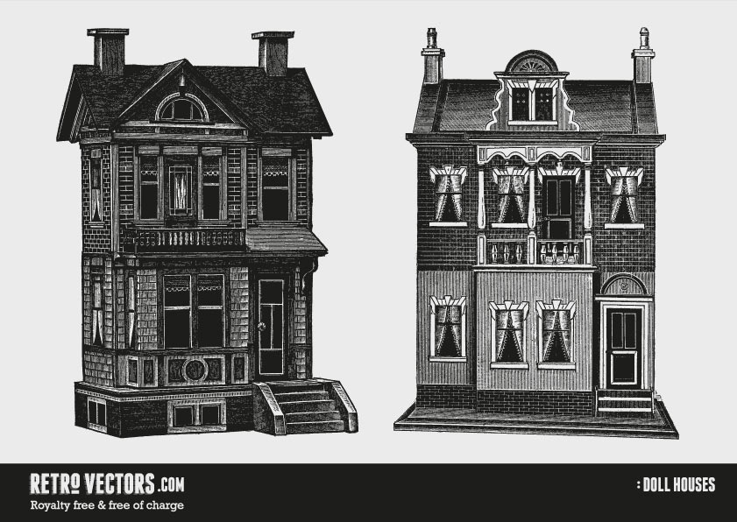

House prizes
Categorical
Low
Medium
High
Very high
Continuous
0
80000
…
…
∞

Slide 4
House prizes
Categorical
Low
Medium
High
Very high
Continuous
0
80000
…
…
∞

Slide 5
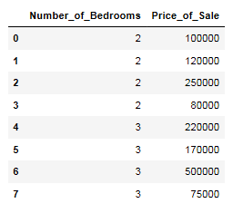
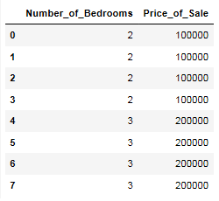
Variance
Real price
Variance
Real price
Real price
Real price

Slide 6
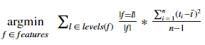
…
…

Slide 7
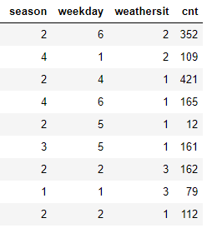
Weekday
1
2
4
5
6
…
…
…
…
…

